Slide 1





Crash course in for Machine Learning
Radmila Velichkovich
University of Neuchatel, Switzerland
Applied Machine Learning Days
January 26-29, 2019
Lausanne, Switzerland
January 26-29, 2019

Slide 2




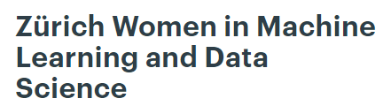




ABOUT ME

Slide 3

Agenda
A word on R, machine learning, and R4ML
Application of R for ML across the industries and various fields of science
Matrix algebra in R (practical session)
Supervised and unsupervised learning: How can R help?
Limitations of R for ML
Leveraging strengths of R and Python
Let's code together: clustering techniques in R (practical session)

Slide 4
AND WHO ARE YOU?
WHAT IS YOUR BACKGROUND?
YOUR EXPERIENCE WITH R/MACHINE LEARNING?

Slide 5

Let's set the things up
SSID: AMLD2019
Password: EPFL2019
The details are on the back of your badges
Timetable:
9.00-10.30 (first chance to change the workshop)
11.00-12.00
Lunch break
13.30-15.00 (last chance to change the workshop)
15.15-16.30

Slide 6
Is this course for you?
This is introductory course to R and machine learning. If you are:
new to R programming
new to machine learning
With no mathematical/programming background
THIS COURSE IS FOR YOU
FEEL FREE TO LEAVE THE COURSE AT ANY TIME IF IT DOES NOT MATCH YOUR PREFERENCES

Slide 7
A word on R,machine learning, and R4ML

Slide 8
A word on R
Programming language supported by more than 10,000 packages
Primarily ideal for statistical programming
Appreciated among data scientists, both in academic and industrial environment
It has industry-specific packages
R studio as its IDE makes R easy to use
It can be used for machine learning but has its pros and cons

Slide 9
A word on machine learning
Did you know?
The term “machine learning” was coined in 1959 by Arthur Samuel
He created a checkers-playing program (self-learning program)
Arthur initially used “rote learning” to train it
The first machine learning conference was held in 1980 in Pittsburgh
The journal Machine Learning began publishing in 1986

Slide 10
What is machine learning?

Slide 11
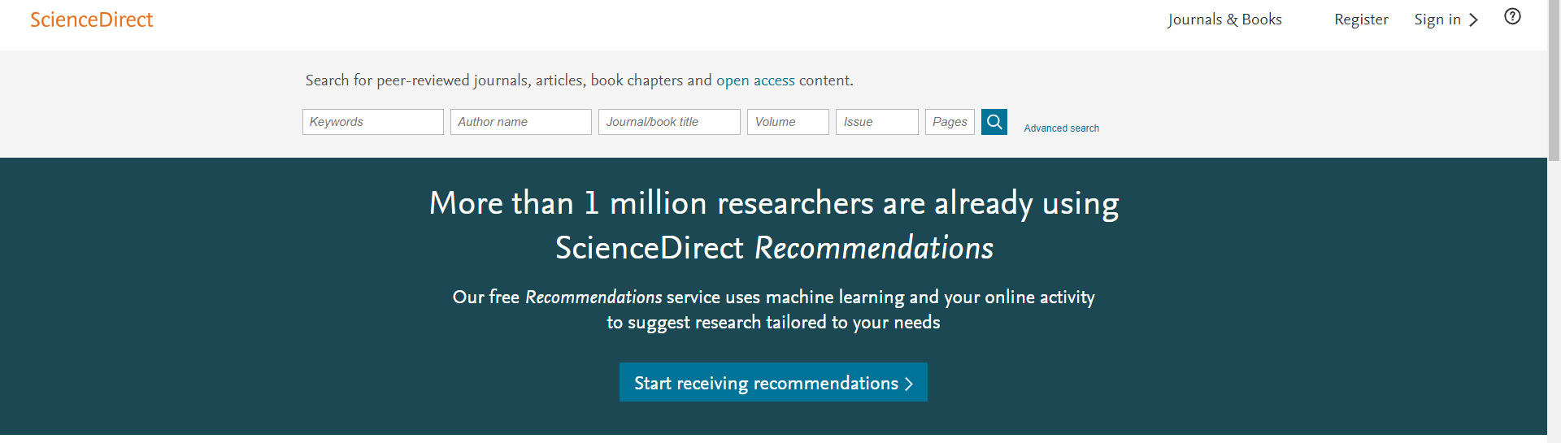

Slide 12

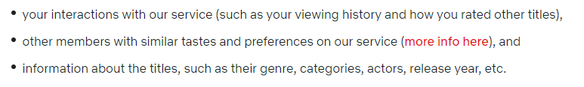
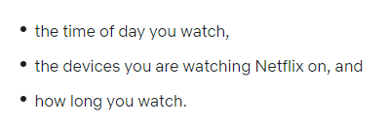
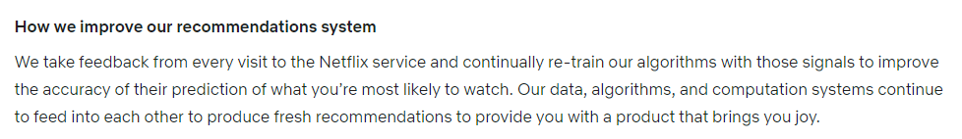
Netflix recommendation system
Likelihood that you will watch a movie is based on:
as well as:
Notes:
source:https://help.netflix.com/en/node/100639

Slide 13

Notes:
http://storybydata.com/datacated-weekly/amazon-knows-it/

Slide 14
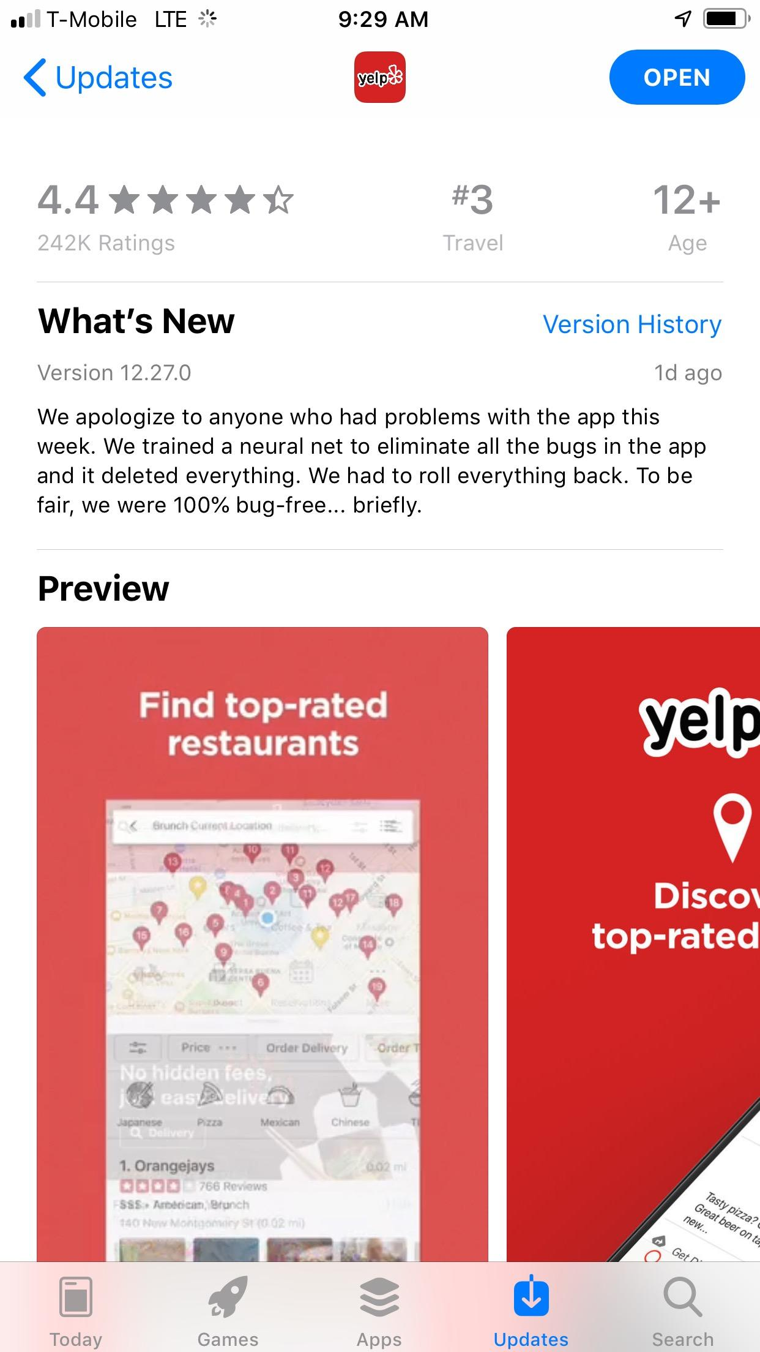
by Araks Stepanyan
Notes:
by Araks Stepanyan

Slide 15

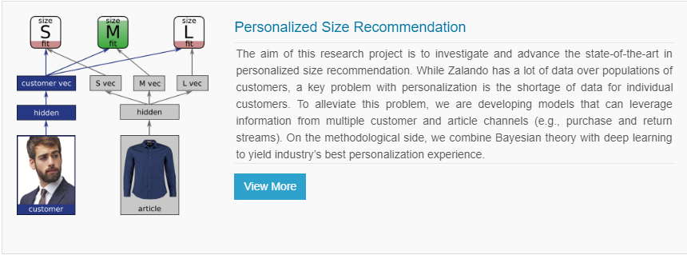
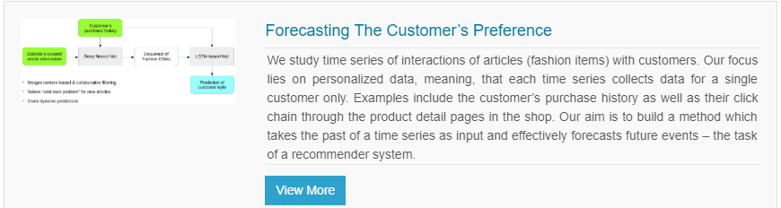

Slide 16


Slide 17
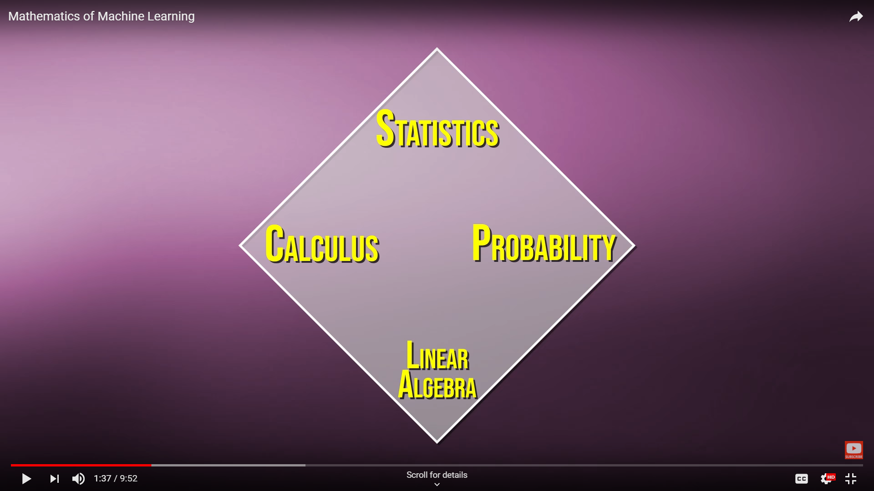
ML relies on
Notes:
https://www.youtube.com/watch?v=8onB7rPG4Pk
Statistics: Inference

Slide 18
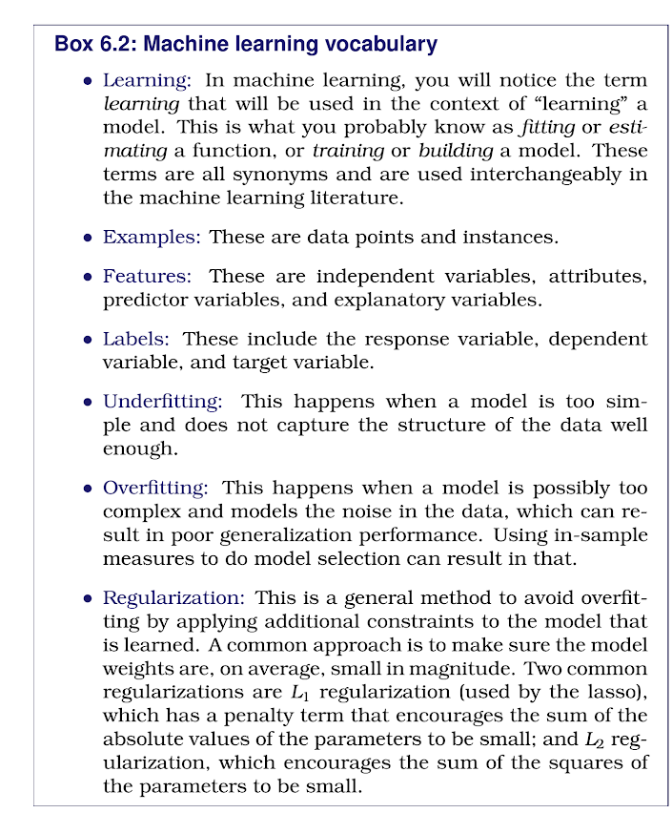
In case you are not familiar with vocabulary
Notes:
Big Data and Social Science: A Practical Guide to Methods and Tools; Ian Foster, Rayid Ghani, Ron S. Jarmin, Frauke Kreuter, Julia Lane

Slide 19
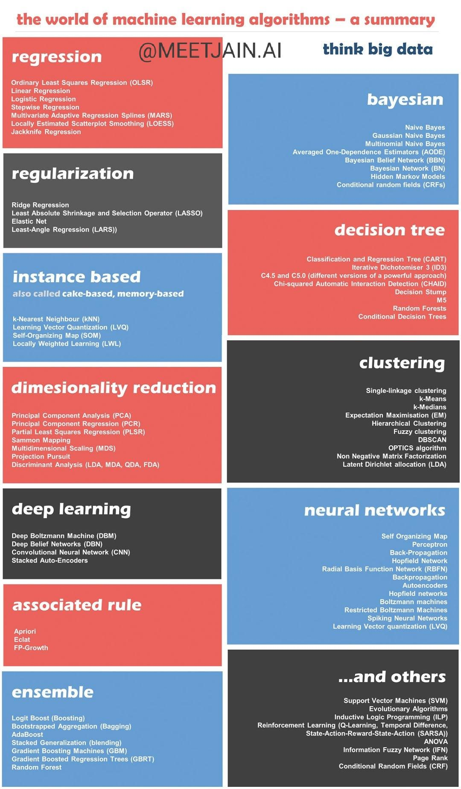

Slide 20
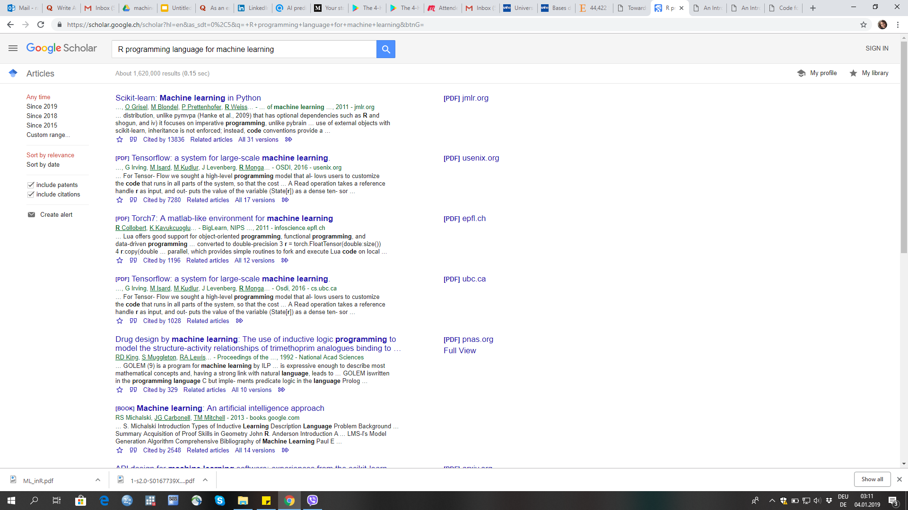

A word on R4ML
?

Slide 21
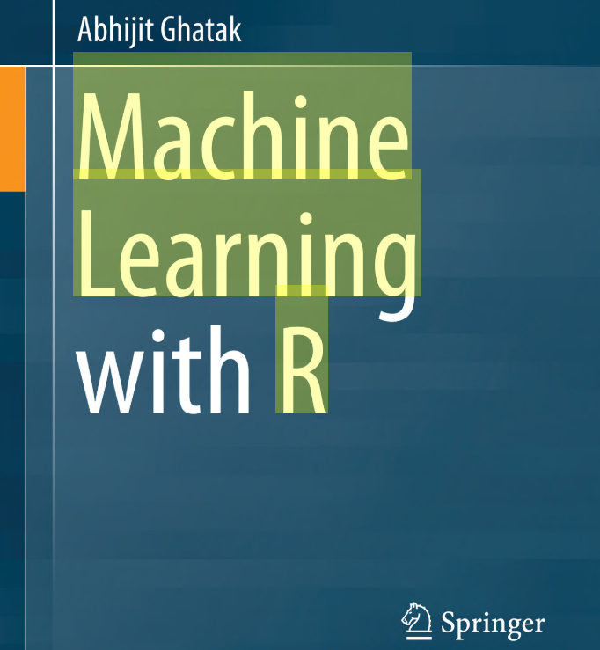
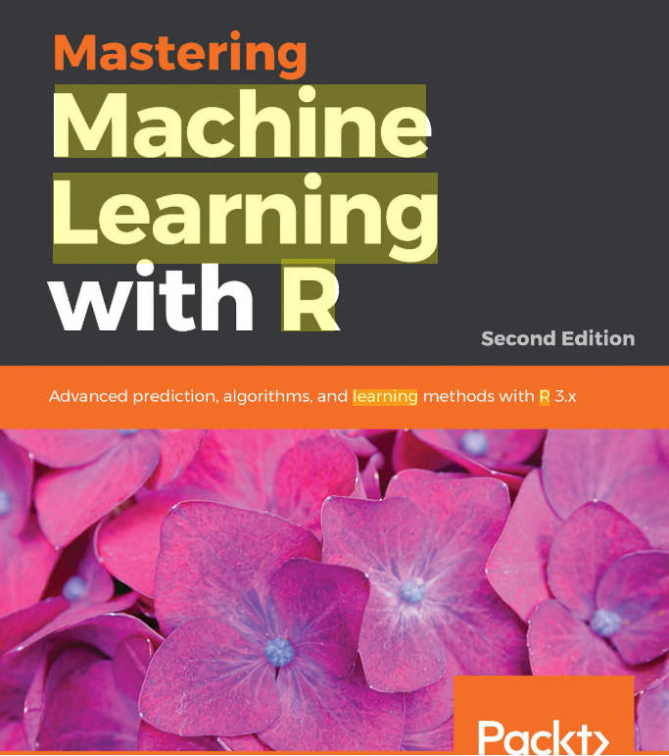
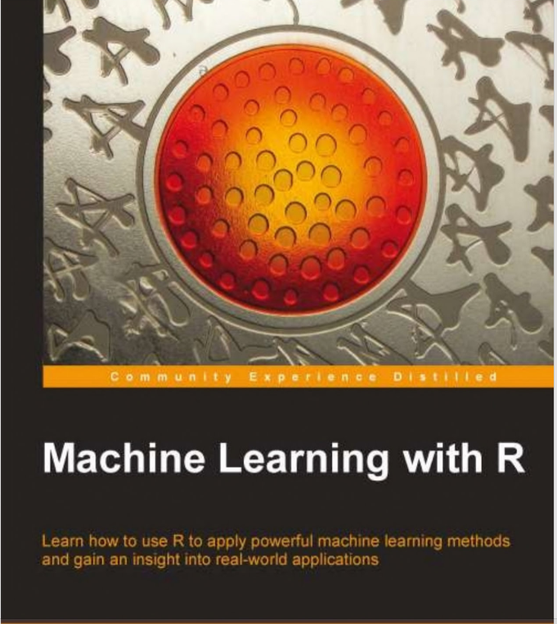
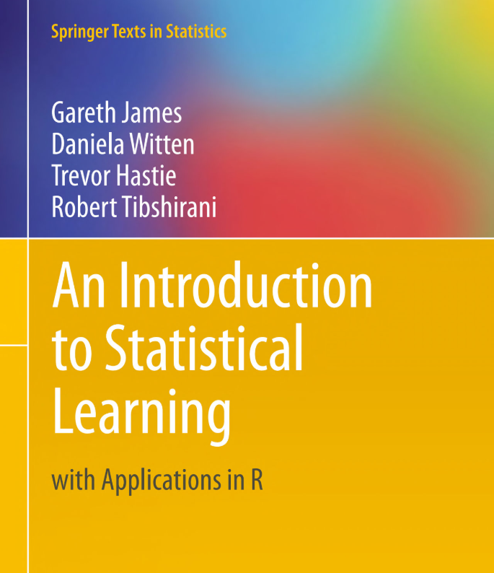
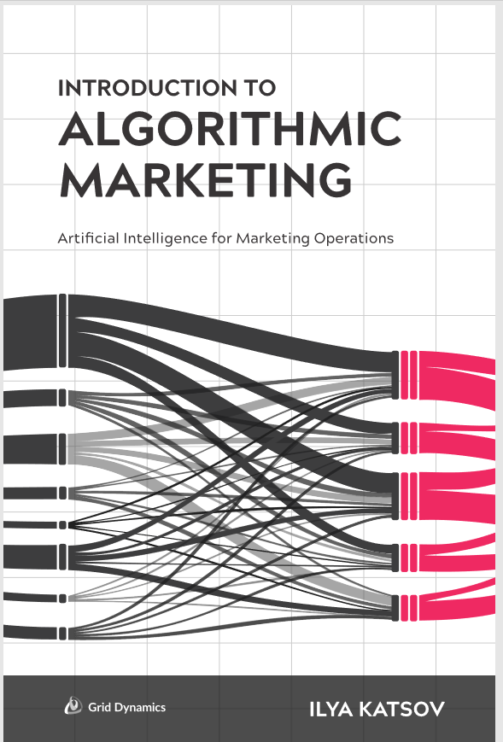
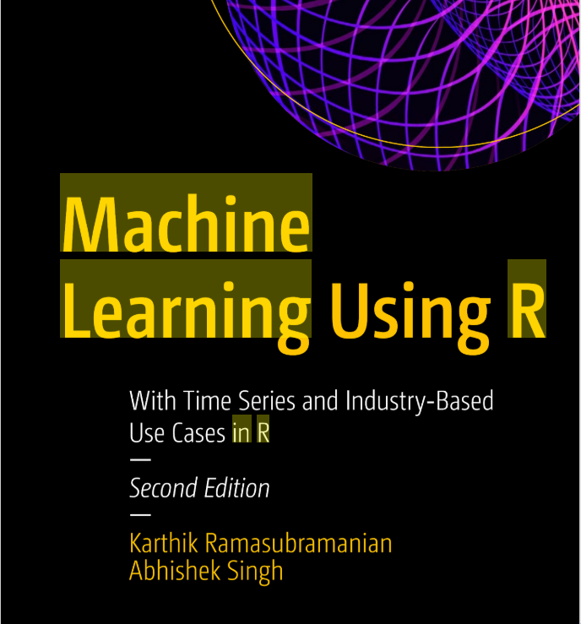
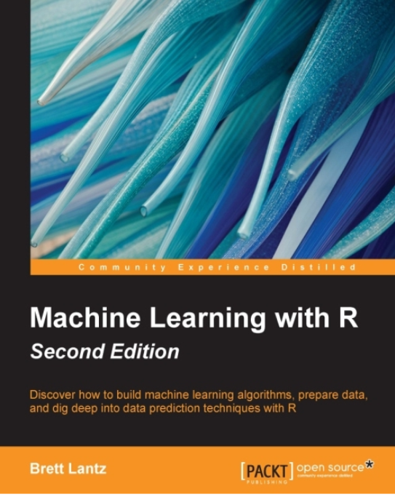
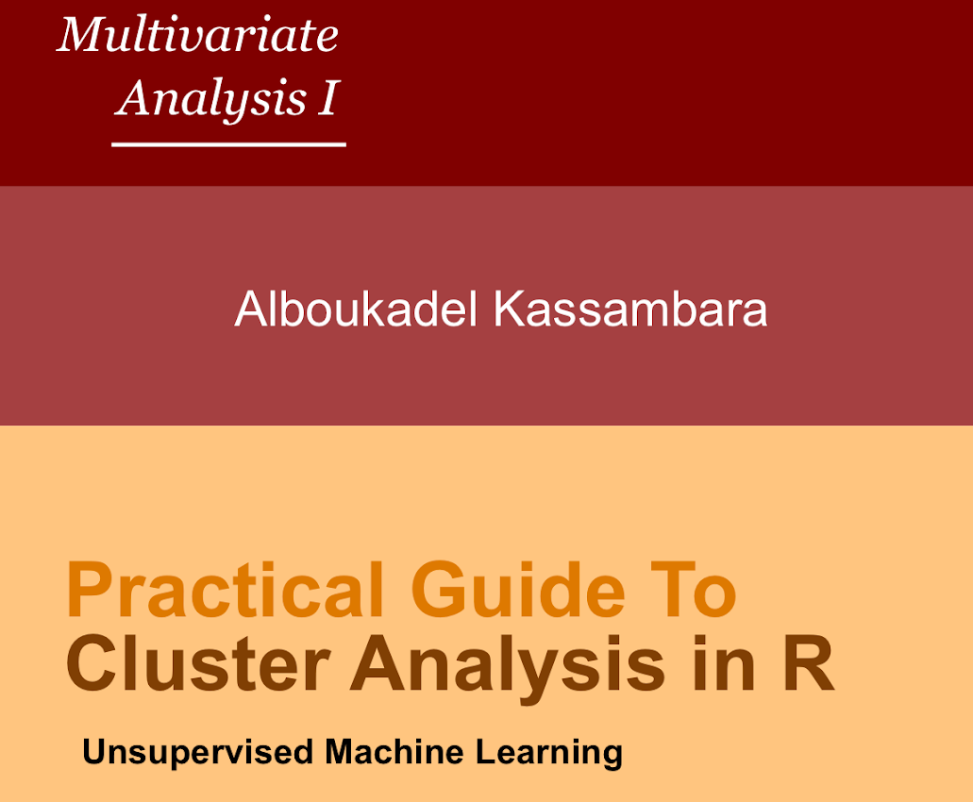
R4ML
Beginner’s guides
Advanced guides

Slide 22
II. Application of R for ML across the industries and various fields of science

Slide 23
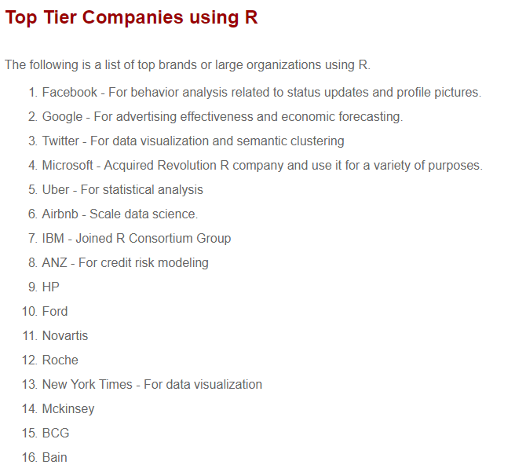
Notes:
https://www.listendata.com/2016/12/companies-using-r.html

Slide 24
Record linkage
One of area of survey methodology that is being explored for a while
The idea is linking two different data sources to gain more insights
Package recordLinkage uses classification model ML whether there is a match or non-match; duplicate or not?
fastLink
PPRL

Slide 25
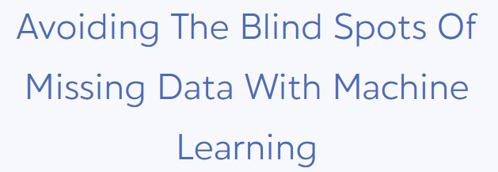
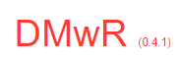
MISSING VALUE ANALYSIS
Uses k-NN approach
Predicting what the missing value could be based on probability or similarity measures

Slide 26
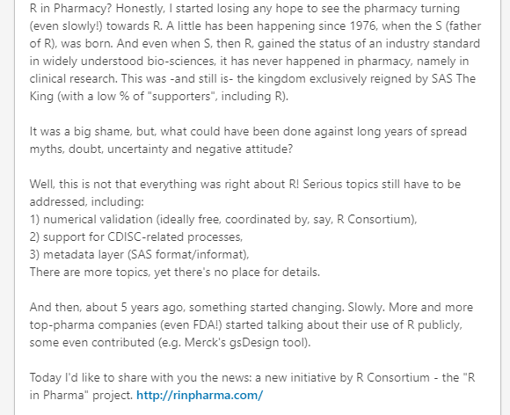
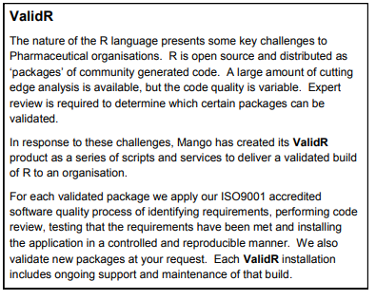

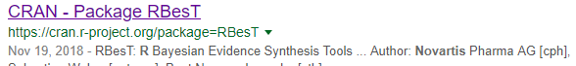
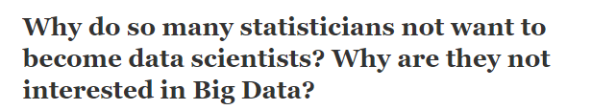
Pharmaceutical data
https://www.quora.com/Why-do-so-many-statisticians-not-want-to-become-data-scientists-Why-are-they-not-interested-in-Big-Data/answer/Adrian-Olszewski-1

Slide 27
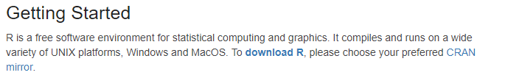

Let´s move forward
Do you all have your R/R studio installed?
R: https://www.r-project.org RStudio: https://www.rstudio.com/products/rstudio/download/
Download the R scripts and dataset from: https://github.com/Radmila-R-lady/CLML
Let´s sta t

Slide 28
III. Matrix algebra
PRACTICAL SESSION

Slide 29

Motivation behind algebra
Machine learning algorithms are based on various matrix operation
You will understand what is behind the scene of regression modelling, PCA, clustering, NLP etc.
Understanding matrices will help you solve the error and warning messages when they pop up
Knowing matrices can help you substitute or modify the algorithms you use
Knowing matrices can help you build your own functions/algorithms
You can then boast off with terms like matrix factorisation, eigenvectors, SVD etc.

Slide 30

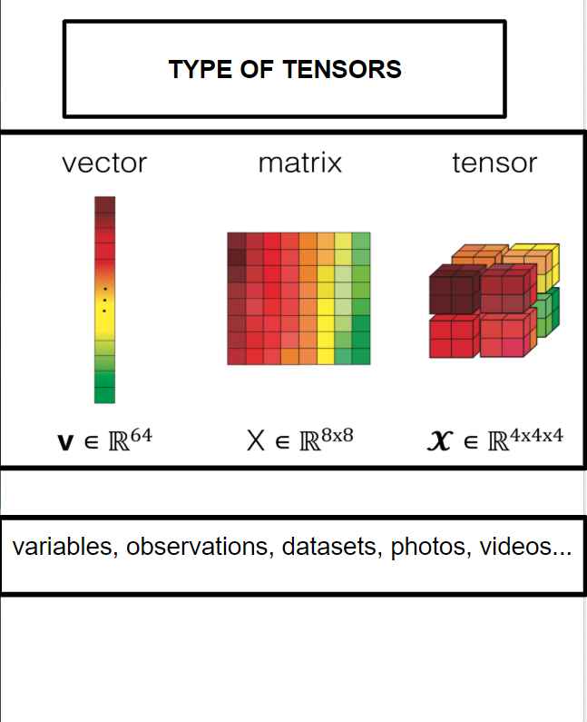
Matrix algebra: Basic terms

Slide 31
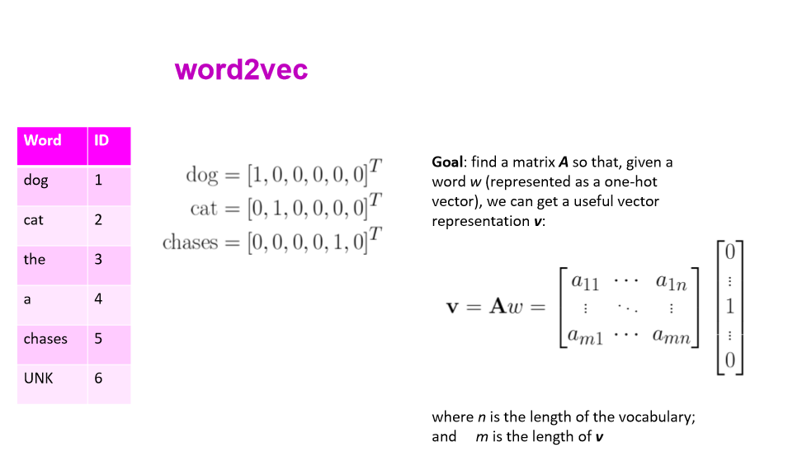
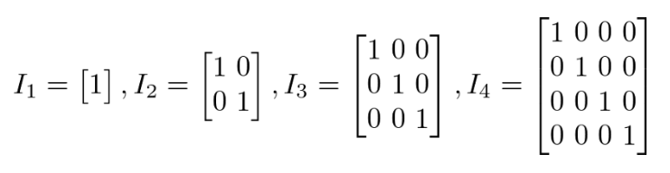
TYPES OF MATRICES
Application
NLP
IDENTITY MATRIX. A matrix with all 1s
on the main diagonal.
Notes:
https://medium.com/@LeonFedden/a-hackers-guide-to-deep-learnings-secret-sauces-linear-algebra-555403c3be16
NLP, courtesy of MLiwicki

Slide 32
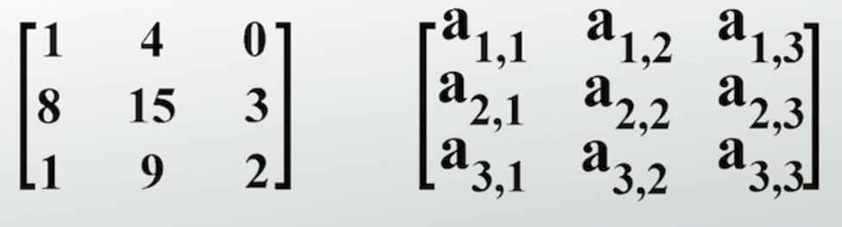
TYPES OF MATRICES
SQUARED MATRIX. A matrix of type
nxn

Slide 33
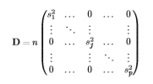
TYPES OF MATRICES
DIAGONAL MATRIX.
Entries outside the main
Diagonal are zeros.

Slide 34
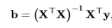
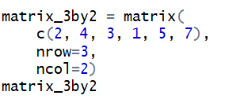
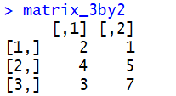
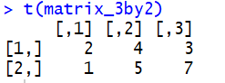
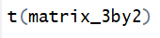
MATRIX OPERATIONS
Applications
Obtaining regression coefficients:
Correlation matrix:
TRANSPOSITION. Columns become rows
We created a matrix
This is what we get
Transpose the matrix
We get matrix 2 by 3

Slide 35
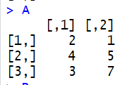
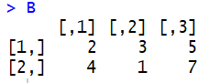
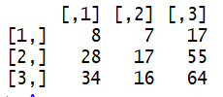
MATRIX OPERATIONS
Applications
Obtaining regression coefficients:
Correlation matrix:
Idempotent matrix:
PP=P
MATRIX MULTIPLICATION. Multiplying matrix by matrix
returns a matrix. Rule for multiplying: number of rows of matrix A
has to be equal to the number of columns of matrix B
Resulting matrix: number of columns of A and number of rows of B
3x2 2x3
3x2 2x3

Slide 36
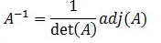
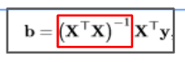
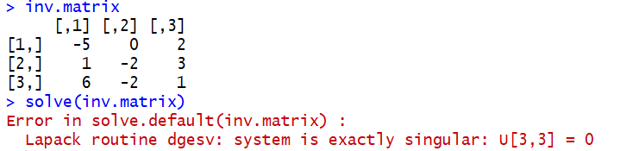
MATRIX OPERATIONS
Applications
Obtaining regression coefficients:
MATRIX INVERSION. If a squared matrix has an inverse
we say it is invertible (non-singular).
If it does not, it is a singular matrix!!!
If the matrix expression in red is not invertible, we cannot find vector b

Slide 37
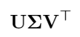
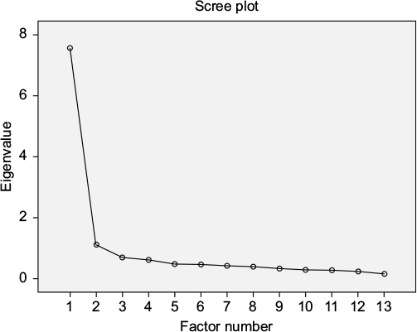
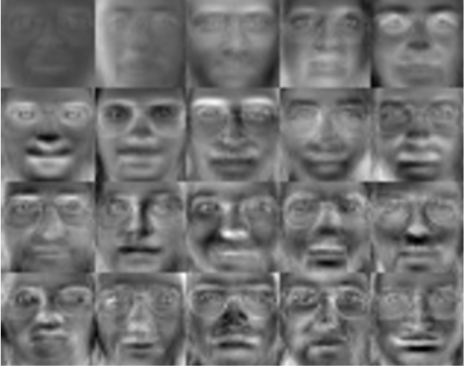
EIGENVECTORS AND EIGENVALUES
MOTIVATION
PCA SINGULAR VALUE DECOMPOSITION (SVD) FACE RECOGNITION
Defining number of components to be retained
eigenfaces=eigenvectors
Eigenvalues: largest eigenvalue provides more info on the face variation
EIGENVECTORS OF Xt(X)
EIGENVECTORS OF t(X)X
Notes:
Eigenfaces are the set of eigenvectors which used in computer vision problem for human face recognition. They can be simply defined as the eigenvectors which represent one of the dimension of face image space. All eigenvectors have an eigenvalue associated to it and the eigenvectors with the largest eigenvalues provide more information on the face variation than the ones with smaller eigenvalues.

Slide 38
Supervised and unsupervised learning: How can R help?
R packages for ML

Slide 39
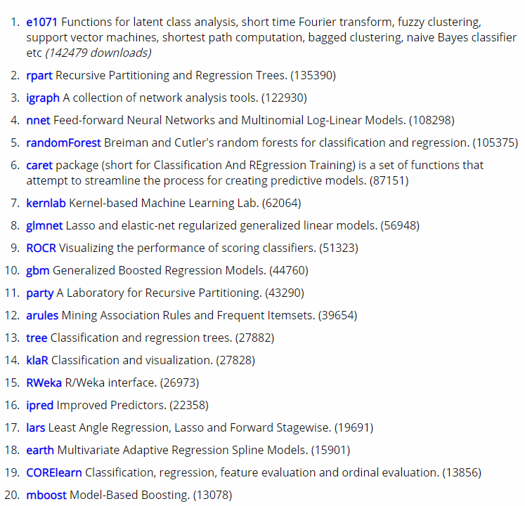
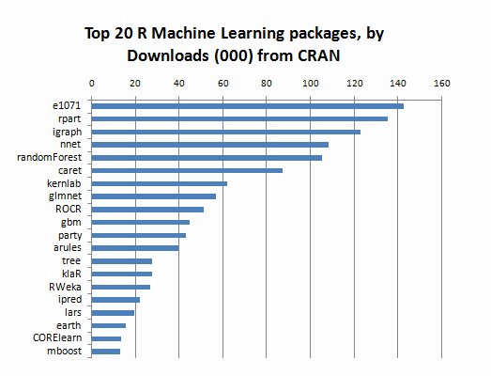
Notes:
https://www.kdnuggets.com/2015/06/top-20-r-machine-learning-packages.html

Slide 40
Limitations of R for ML

Slide 41
Limitations of R for ML
MEMORY CONSUMPTION. Solution could be using some memory optimization packages.
SLOW SYNTAX. “Computationally expensive”
USER NEEDS. Some packages and functions in them might not meet the requirements of the user. This is typically discussed within Neural Networks.
INDUSTRY. not suited to building models to be deployed in scalable or operational environments.

Slide 42

Leveraging strengths of R and Python
R interface to Python (reticulate)

Slide 43

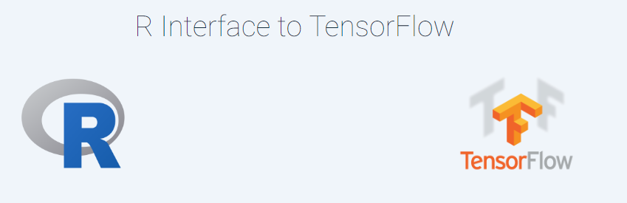
Is it possible to run R and Python code in the same Jupyter notebook?
Yes! What you coded in R can be executed in Python´s Jupyter notebook. Package needed to do it is rpy2.
Keras and R
R has Interface to the Keras Deep Learning Library
R and Tensorflow
R has Interface to TensorFlow

Slide 44





Let's code together: clustering techniques in R (practical session); INTRO
maximizing similarity between entities within a cluster and maximizing difference among the clusters
can be applied in many fields of science: biology, social sciences, market research etc.
no strict rules how to conduct cluster analysis (variable choice, distance measures etc.)
contextual knowledge plays big role in defining the approach to clustering
experiment with your data, change inputs, play with parameters until you find stable solution
that is in line with your research (business) strategy

Slide 45
Let's code together: clustering techniques in R (practical session); INTRO
h
CLUSTERING METHODS
HIERARCHICAL
NON-HIERARCHICAL
AGGLOMERATIVE
DIVISIVE
K-MEANS

Slide 46
NON-HIERARCHICAL CLUSTERING: k-means
The easiest and the most used (at least in market research and social sciences)
Well-known for its high intra-class/low inter-class similarity efficiency
It requires to specify the number of clusters k in advanced.What does this tell you?
Each cluster is represented by centroid
It is flexible as it reassigns objects from cluster to cluster
It is used to “fine-tune” hierarchical procedures
It is sensitive to outliers/zero-inflated variables/does not support weights
The function in R does not support variable weights

Slide 47
R session:Finding teen market segments

Slide 48

Do you notice any pattern?

Slide 49


Slide 50
Let's code together: clustering techniques in R (practical session); R packages
R packages for clustering (at least some of them):
cluster (https://cran.r-project.org/web/packages/cluster/cluster.pdf)
factoextra (https://cran.r-project.org/web/packages/factoextra/factoextra.pdf)
diceR (https://cran.r-project.org/web/packages/diceR/index.html)
tresher (https://cran.r-project.org/web/packages/Thresher/index.html)
mclust ()
whiboclustering (https://cran.r-project.org/web/packages/whiboclustering/whiboclustering.pdf)
bigmemory( )k-means on very big data using parallel processing
bigAnalytics ()k-means on very big data using parallel processing
Stats (k-means)

Slide 51


Cluster analysis procedure
DEFINING PARTITIONING PROCEDURE
Each object starts as its own cluster
AGNES (Agglomerative Nesting)
All objects represent one cluster (singleton cluster)
DIANA (Divisive Analysis)
Notes:
Picture taken from: https://quantdare.com/hierarchical-clustering/

Slide 52


Cluster analysis procedure
MEASURES OF SIMILARITY
In order to decide which objects/clusters should be combined or divided, we need methods for measuring similarity.
Most used are Euclidean and Mahalanobis distance. The literature provides many more. Each of them has mathematical properties, advantages and disadvantages.
R can incorporate all of them as an argument:

Slide 53


Cluster analysis procedure
DENDROGRAM INTERPRETATION

Slide 54
R: USArrest dataset

Slide 55

Cluster analysis procedure
Could have we done something before actual clustering?
PCA is great tool to visualise the data structure before running k-means
Do you see any structure?
How will it affect using k-means?
Tip: Use k-means algorithm with caution, you will have to argument your results.

Slide 56
TAKEAWAY MESSAGES
Mathematics is important.
Knowing how to code is great but try to understand what the function tells you.
Play around with the arguments of a function and iterate the process.
What I told you on clustering is not unique way of dealing with it. Many more interesting things can be done to evaluate the solutions.
Stay curious, ask questions, look for similarities and differences of algorithms. Data are of different quality and you have to adjust your approach.
Be ready to argument what you applied.

Slide 57
USEFUL LINKS
About reticulate: https://rstudio.github.io/reticulate/
https://www.mango-solutions.com/blog/snakes-in-a-package-combining-python-and-r-with-reticulate
R Interface to Tensorflow: https://tensorflow.rstudio.com/
R Interface to Keras: https://cloud.r-project.org/web/packages/kerasR/vignettes/introduction.html
List of ML datasets: https://en.wikipedia.org/wiki/List_of_datasets_for_machine_learning_research

Slide 58




UPCOMING EVENTS IN Switzerland
CHECK ALSO:

Slide 59
ANY QUESTION, COMMENT, FEEDBACK?

Slide 60
Follow me on:
LinkedIn: https://www.linkedin.com/in/radmila-velichkovich-8a90b044/
Twitter: https://twitter.com/Radmila_R_Lady
Medium: https://medium.com/@radmila.velichkovich
THANK YOU

